Slide 1


Heads Up
Tackling Headache
Tackling HEADACHE
KS3 Lesson
Get to grips with headache in schools
Notes:
https://www.flaticon.com/free-icon/headache_2269017

Slide 2
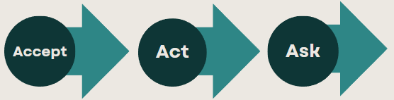
We are learning about headaches, their causes, and what to do if you get them.
We will be able to:
Discuss the common yet often misunderstood topic of headaches.
Explain that headaches can affect anyone
Understanding their causes
Describe ways to manage them
Understand the link between headache and wellbeing
Get to grips with headache in schools
Notes:
Teacher Notes- Learning objectives and outcome
Introduce the learning objectives and outcomes, explain that today's lesson intends to educate students about headaches, their causes, and strategies for prevention and management.
“We’ll explore the common yet often misunderstood topic of headaches. Headaches can affect anyone, and understanding their causes and ways to manage them is crucial for overall well-being.”

Slide 3

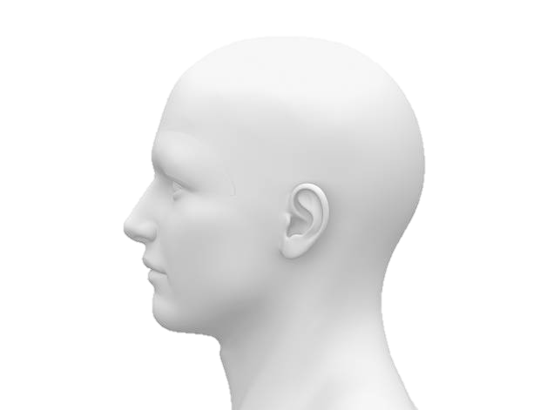
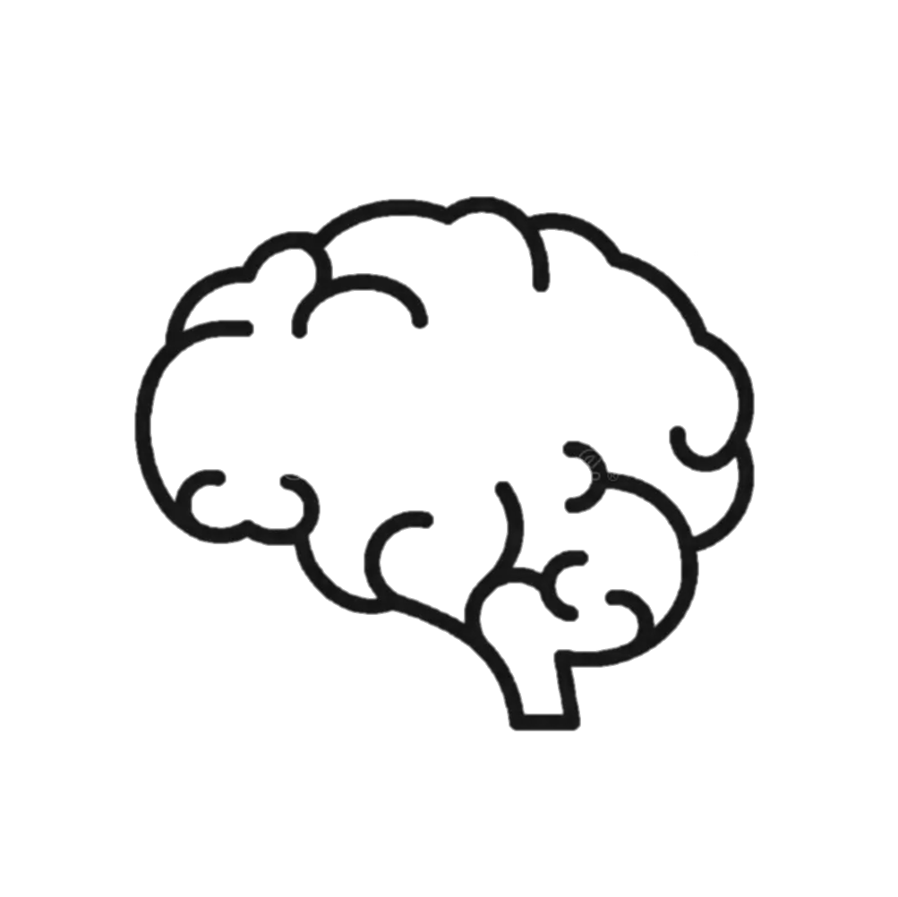



How might these things effect our heads?
Starter
Doing homework on a computer for several hours
Worrying about a test that’s coming up
Going to a concert
Eating dark chocolate
Drinking energy drinks
The smell of chemicals
Get to grips with headache in schools
Notes:
Teacher’s Notes – Baseline –Think Pair Share
Students are to begin thinking about this on their own – then share ideas with those around them. This slide could be printed off to enable annotation.
As this is the baseline assessment its important to keep language natural and allow students to share ideas freely
Use this activity to gauge students current understanding and adapt the lesson throughout to prior knowledge or understanding that the students may have/ need.

Slide 4
What is a Headache?
Discuss
How do you feel when you have a headache?
What are your symptoms?
Get to grips with headache in schools
Notes:
Teachers Notes- Activity 1 – what is a headache?
Begin by discussing what a headache is and the different types. Mention common types such as tension headaches, migraines, and cluster headaches. Emphasize that headaches are a symptom, not a disease.

Slide 5
Video
As you watch the video consider these questions
Get to grips with headache in schools

Slide 6
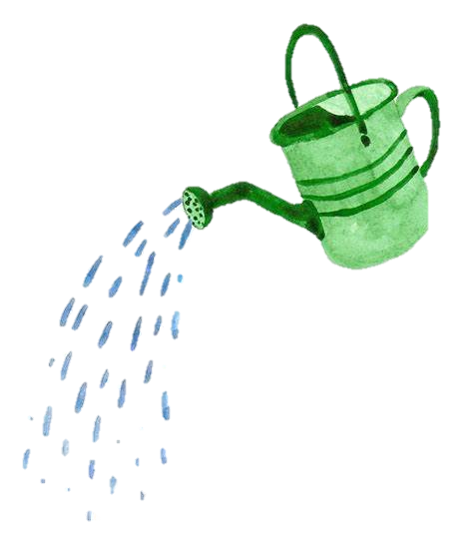
What are you putting in your head?
What factors can contribute to head pain?
Causes of Headache:
Discuss
Noise
Eye Strain
Caffeine and Sugar
Strong Smells
Stress
What else could cause head pain?
Get to grips with headache in schools
Notes:
Teachers Notes- Activity 3: Identifying Triggers
Explore the various factors that can contribute to headaches:
Stress
Dehydration
Lack of sleep
Poor posture
Eye strain
Caffeine withdrawal
Certain foods
The cause could also be more serious – head injury, tumour etc

Slide 7



Head Pain Scenarios
Task 1
 |  | Cause | Symptoms | Treatment | Serious?
1 | Olivia, an avid gamer, lost track of time during an intense gaming marathon with her friends. The combination of prolonged screen exposure, bright graphics, and the adrenaline rush triggered a migraine. As the symptoms intensified, Olivia reluctantly abandoned her controller, retreating to a quiet, dark room to alleviate the pounding headache and regain her composure.
2 | Raf, a music enthusiast, attended a loud and intense concert with their friends. The combination of flashing lights, booming music, and the crowded venue triggered a pain in his head. Raf struggled with the throbbing pain, noise sensitivity, and visual disturbances.
3 | During a crucial football game, Molly collided with another player, resulting in a head injury. She experienced intense head pain, dizziness, and confusion. Molly’s teammates and coaches were concerned.
4 | Mahmoud, a dedicated football player, spent a hot afternoon practicing drills and perfecting his moves on the field. He forgot to bring a water bottle with him. Dehydrated and tired, he developed a headache.
5 | Zek, while attempting a risky stunt on his skateboard, lost balance and fell, hitting his head on the pavement. He complained of excruciating head pain and exhibited signs of a serious injury.
6 | Trudy, a 15-year-old, began experiencing intermittent headaches that gradually increased in frequency and intensity over several weeks. The headaches were often accompanied by nausea, vision changes, and difficulty concentrating.
7 | Arwen, a diligent Year 9 student, found herself engrossed in a challenging math homework late into the night. The pressure to do well in her exams combined with the hours of concentration triggered a headache.
8 | Wilfred, a 16-year-old, started noticing unexplained changes in his coordination, including difficulties with balance and frequent episodes of dizziness. Alongside these symptoms, he experienced severe headaches that didn't respond to over-the-counter pain relievers.
1. What might the cause of the pain be?
2. What are the symptoms?
3. Where might they get support or treatment?
Cause
Symptoms
Treatment
Get to grips with headache in schools
Notes:
Teachers Guidance -Task 1: Head Pain Scenarios
1. What might the cause of the pain be?
2. What are the symptoms?
3. Where might they get support or treatment?

Slide 8



Get help or help yourself?
Task 2
Serious or not?
Medicine
Rest
Help
Get to grips with headache in schools
Notes:
Teachers Guidance- Task 2: Get help or help yourself?
Medicine Rest Help
Use the ws to gather information

Slide 9
Headache is more common in students who skip breakfast, don’t drink enough water and have been bullied in the past.
Why do you think this is?
Headache can also be connected to mental health problems.
Information
17% of students say that they don’t eat breakfast
8% of students say that they don’t drink water during the day
Get to grips with headache in schools
Notes:
Teachers Guidance- Information 1

Slide 10
Headache and Wellbeing
Information
The Complex, inter
-
related elements involved in problematic headache.
Migraine has a strong genetic element.
Erratic
food
intake,
Family, relationship
p
oor diet, lack exercise,
problems
l
ack hydratio
n
Anxiety, low mood
School pressures
Poor sleep
Bullying
Genetic predisposition
Get to grips with headache in schools

Slide 11

Does anyone listen?
Discuss
Adults don’t always listen to young people who report that their head hurts.
Why do you think this is?
What does ‘stigma’ mean?
Get to grips with headache in schools
Notes:
Teachers Notes - Stigma

Slide 12

Sometimes headache is simply fixed
Head First Aid
Plenary
Water
Sleep
Exercise
Pain Killer (a small does of paracetamol or similar)
Limited Screen time (including homework)
Check your lighting
Get to grips with headache in schools

Slide 13
When to go to the GP
Information
Your head pain is getting worse
A change is how the head pain ‘acts’
Head pain that seems connected to other things (For example, double vision, weakness or memory loss)
If head pain starts suddenly after exercise, coughing or straining
Its not settling with simple pain killers
Get to grips with headache in schools
Notes:
Recognising Warning Signs: Discuss warning signs that may indicate a more serious issue, such as chronic headaches or migraines. Encourage students to seek medical advice if they experience severe or persistent headaches.

Slide 14

Signposting
Signposting
Home - The Migraine Trust
https://www.nhs.uk/conditions/headaches/10-headache-triggers/
The Exeter Headache Clinic
Get to grips with headache in schools

Slide 15
Keywords
Stigma
Trigger
Migraine
Aura
Cluster headache
Get to grips with headache in schools

