Slide 1
Heads Up Tackling Headache
Tackling HEADACHE
KS4 Lesson
Get to grips with headache in schools

Slide 2
We are learning about headaches, how they impact upon young people and their association with stress and mental wellbeing
We will be able to:
To identify causes, symptoms, and effective treatments for headaches.
To help students understand the connection between stress, mental wellbeing, and headaches.
To provide practical stress management techniques and encourage healthy lifestyle choices.
Get to grips with headache in schools
Notes:
Headaches particularly migraine can occur out of the blue in the absence of stress. Migraine is a genetic problem that runs in families but it can be made worse by stress.

Slide 3
World ranking for disability under 25 years old (WHO 2019) | Problem
1. | Road injury
2. | Headache disorders
3. | Self harm
4. | Depressive disorders
5. | Violence
6. | Anxiety
Notes:
Headache is number 2 in the world in terms of disability in young people

Slide 4
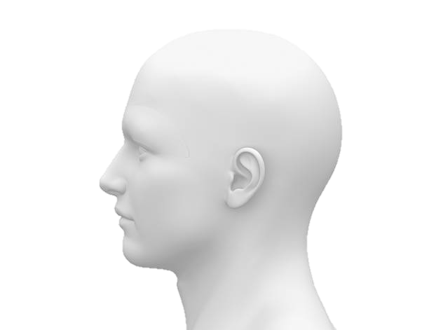
1. Types of Headaches Tension Headaches: The most common type of headache caused by stress, characterised by a dull, aching pain around the head. Migraines: Severe headaches that can be triggered by a number of things including stress, involving intense, throbbing pain often accompanied by nausea and sensitivity to light and sound. In some people there can be pins and needles or visual disturbances known as an aura. Lasts between 1 and 4 hours in general. Migraine tends to run in families.
Types of Headaches
Discuss
Get to grips with headache in schools
Notes:
- Introduce the two main types of headaches : tension headaches and migraines. There are others (for example cluster headache) but these are the main ones by far.
- Describe the symptoms of each type of headache.
- Use visual aids or diagrams to help explain the differences between tension headaches and migraines.

Slide 5
Headache and seeking help
Young people with headache don’t seek help. Why do you think this is?
Get to grips with headache in schools
Notes:
Explain stigma. Don’t like things we can’t see or measure. No one takes it seriously.

Slide 6
Headache and Wellbeing
Information
The Complex, inter
-
related elements involved in problematic headache.
Migraine has a strong genetic element.
Erratic
food
intake,
Family, relationship
p
oor diet, lack exercise,
problems
l
ack hydratio
n
Anxiety, low mood
School pressures
Poor sleep
Bullying
Genetic predisposition
Get to grips with headache in schools
Notes:
There are many things that can make headache worse. We going to focus on stress as this is most common although migraine can occur out of the blue.

Slide 7
Disorder | No headache % of young people with a problem | Tension headache | Migraine
Depression disorders | 12% | 20% | 27%
Anxiety disorders | 17% | 26% | 30%
Anxiety and depression | 5% | 9% | 11%
Notes:
Stress can make headache worse although stress is not always related to headache

Slide 8
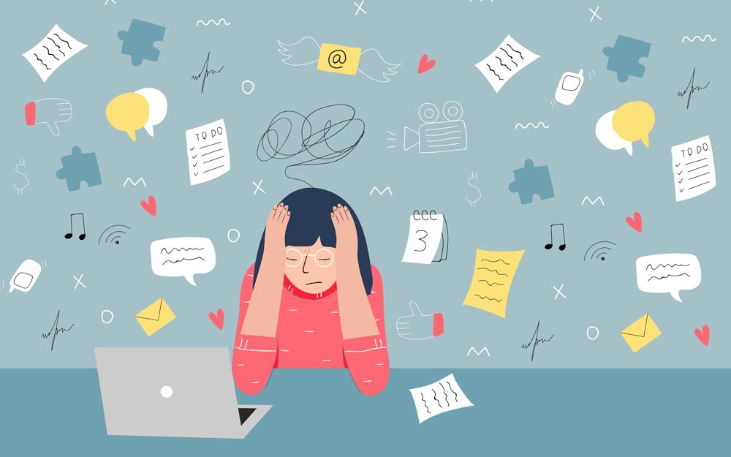
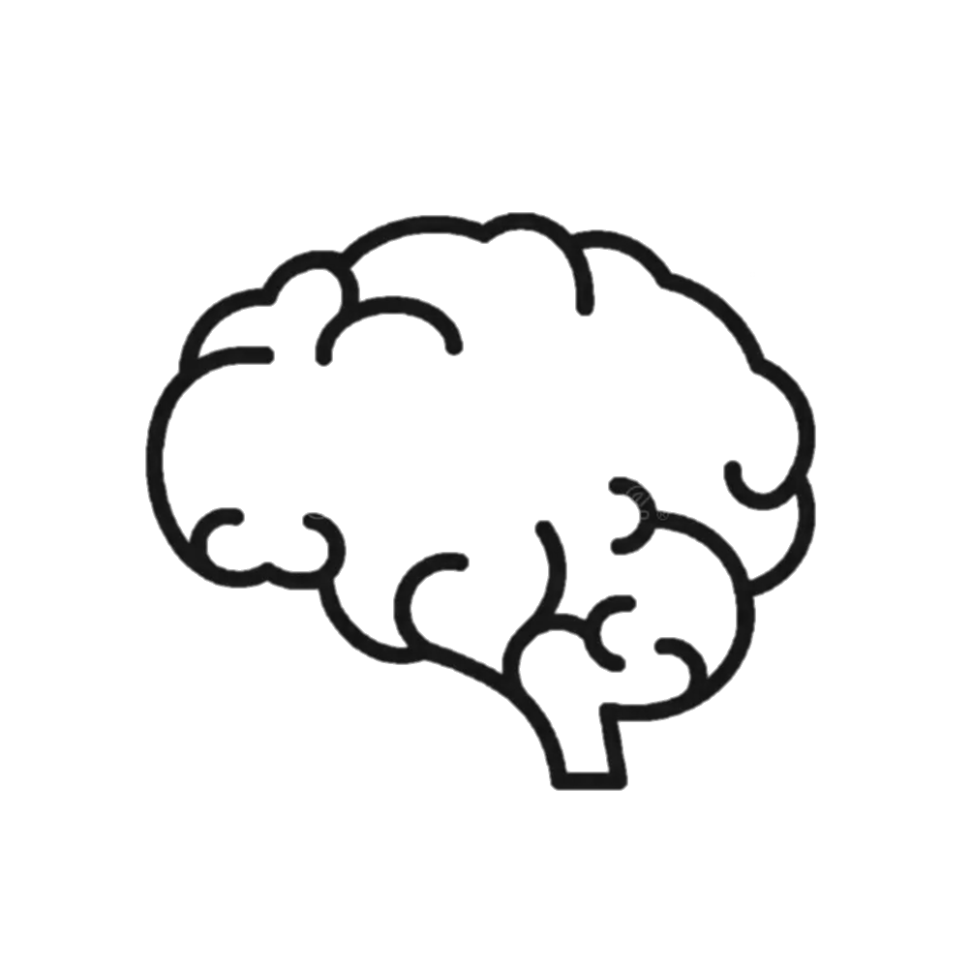
Understanding Stress
Starter
How does stress make you feel?
Stress is the body's response to any demand or challenge. It can be caused by various factors, including schoolwork, relationships, or major life changes.
Get to grips with headache in schools

Slide 9
Types of Stress
Discuss
Acute Stress: Short-term stress that goes away quickly (e.g., before a test).
Chronic Stress: Long-term stress that persists over an extended period (e.g., ongoing family problems).
What impact can stress have on your happiness, health and well being?
Get to grips with headache in schools

Slide 10
How Stress Affects Mental Wellbeing
Information
1. Impact on Mental Health
Emotional Effects: Stress can lead to feelings of anxiety, irritability, and depression.
Cognitive Effects: It can impair concentration, memory, and decision-making abilities.
Get to grips with headache in schools
Notes:
Explain the impact of stress on mental health, including emotional and cognitive effects.
- Discuss the physical symptoms of stress, focusing on how the fight-or-flight response works.

Slide 11
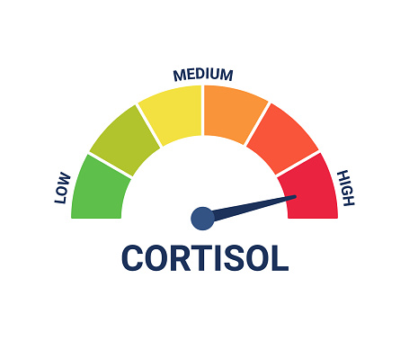
How Stress Affects Mental Wellbeing
Information
2. Physical Symptoms of Stress
Common Symptoms: Tiredness, trouble sleeping, muscle tension, and headaches.
Fight-or-Flight Response: Stress triggers the body's fight-or-flight response, releasing hormones like adrenaline and cortisol, which prepare the body to either fight or flee.
Get to grips with headache in schools
Notes:
Explain the impact of stress on mental health, including emotional and cognitive effects.
- Discuss the physical symptoms of stress, focusing on how the fight-or-flight response works.

Slide 12
Causes of Stress and Headaches
Discuss
1. Common Causes of Stress
Academic Pressure: Exams, homework, and future career concerns.
Social Issues: Peer pressure, relationships, and social media.
Personal Life: Family conflicts, health problems, and personal expectations.
2. How Stress Triggers Headaches
Muscle Tension: Stress can cause muscles in the neck and scalp to tighten, leading to tension headaches.
Hormonal Changes: Stress hormones can cause changes in the brain that lead to migraines.
Get to grips with headache in schools
Notes:
Discuss common causes of stress, especially those relevant to teenagers (academic pressure, social issues, personal life).
- Explain how stress triggers headaches, focusing on muscle tension and hormonal changes.

Slide 13
Managing Stress and Preventing Headaches
Discuss
Managing Stress and Preventing Headaches
1. Healthy Lifestyle Choices
Regular Exercise: Physical activity releases endorphins, which can reduce stress and prevent headaches.
Balanced Diet: Eating nutritious meals at regular intervals keeps energy levels stable and reduces stress.
Adequate Sleep: Ensuring 8-10 hours of sleep helps the body recover and manage stress better.
2. Stress Management Techniques
Relaxation Exercises: Deep breathing, meditation, and yoga can help calm the mind and reduce stress.
Time Management: Prioritizing tasks and breaking them into manageable steps can reduce feelings of being overwhelmed.
Hobbies and Interests: Engaging in activities you enjoy can provide a break from stress and boost your mood.
3. Seeking Help
Talk to Someone: Sharing your feelings with friends, family, or a counsellor can provide support and reduce stress.
Professional Help: If stress and headaches become overwhelming, seek help from a healthcare professional, such as a psychologist or doctor.
Get to grips with headache in schools
Notes:
- Share healthy lifestyle choices that help manage stress and prevent headaches:
- Regular exercise
- Balanced diet
- Adequate sleep
- Introduce stress management techniques:
- Relaxation exercises (demonstrate or play a guided meditation)
- Time management tips
- Engaging in hobbies and interests
- Emphasize the importance of seeking help:
- Talking to someone they trust
- Seeking professional help if needed

Slide 14
Causes of Stress and Headaches
Discuss
Discussion Questions
What are some common causes of stress in your life?
How do you usually manage stress? Are there any new techniques you would like to try?
Have you ever experienced headaches related to stress? How did you handle them?
Activities
Relaxation Exercise: Let's try a short guided meditation or deep breathing exercise.
Stress Journal: Start a journal to track your stress levels and identify patterns or triggers.
Group Discussion: Share stress management tips and support each other in finding new ways to cope.
Get to grips with headache in schools

Slide 15
Remember…
Final thought
Remember, managing stress is a continuous process, and it's okay to seek help when needed. Taking care of your mental wellbeing is just as important as taking care of your physical health.
Get to grips with headache in schools

Slide 16
Sometimes headache is simply fixed
Headache First Aid
Plenary
Water
Sleep
Exercise
Pain Killer (a small does of paracetamol or Ibuprofen)
Limited Screen time (including homework)
Check your lighting
Address any worries
Get to grips with headache in schools

Slide 17
When to go to the GP
Information
Your head pain is getting worse
A change is how the head pain ‘acts’
Head pain that seems connected to other things (For example double vision, weakness or memory loss)
If head pain starts suddenly after exercise, coughing or straining
Get to grips with headache in schools

Slide 18
Signposting
Signposting
Heads up information for students
Home - The Migraine Trust
https://www.nhs.uk/conditions/headaches/10-headache-triggers/
The Exeter Headache Clinic
Get to grips with headache in schools

Slide 19
Keywords
Trigger
Migraine
Tension headache
Aura
Stigma
Treatment
Cause
Symptom
Get to grips with headache in schools

